Slide 1
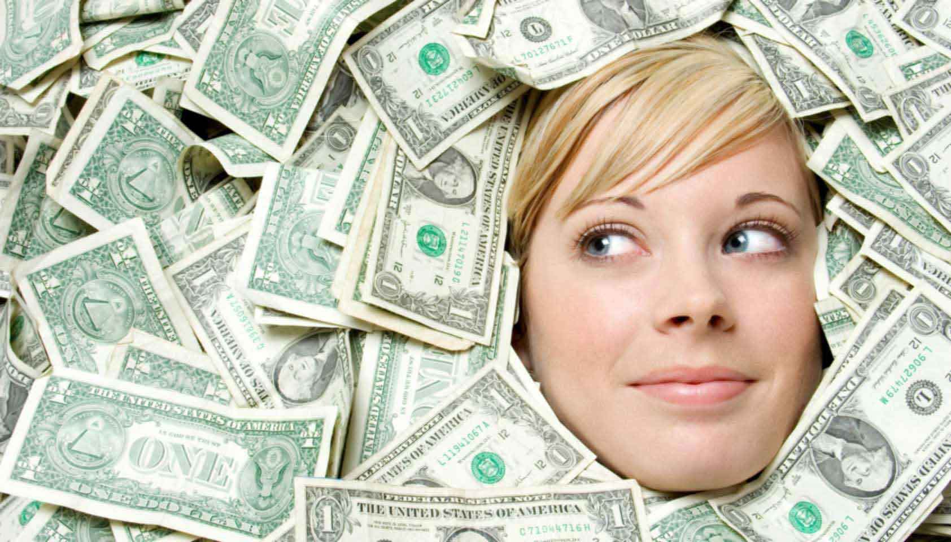
Stingy
-being unwilling to spend money
He is greedy for money.

Slide 2
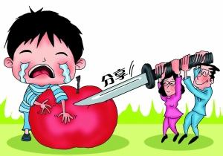
Selfish
-he or she cares only about himself or herself, and not
about other people
He plans to have a lawyer to his son and the other young man, but he doesn’t want to help his brother’s son.

Slide 3
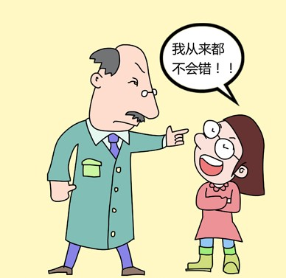
Self-satisfied
-they are too pleased with themselves about their achievements or their situation and they think that nothing better is possible
He thinks his is the one who can have enough experience to live in Johannburg, even though his wife left him and his brother talked with him. Also he thinks this place is suitable for him.
I will not get wrong forever!

Slide 4
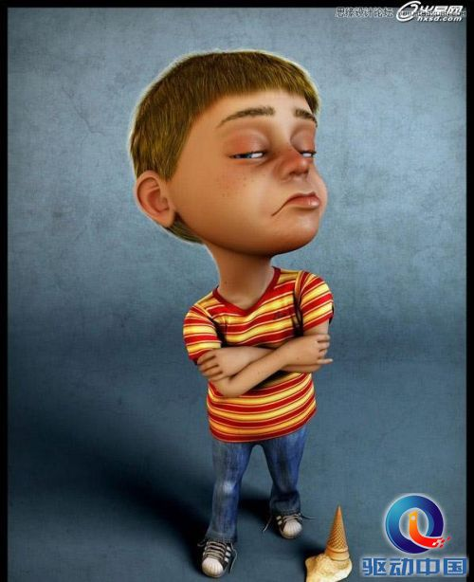
haughty
describe someone's behavior or appearance when
you disapprove of the fact that they seem to be very
proud and to think that they are better than other people
When Stephen tries to talk with his brother about his son, his brother ignore him and walk away.

Slide 5
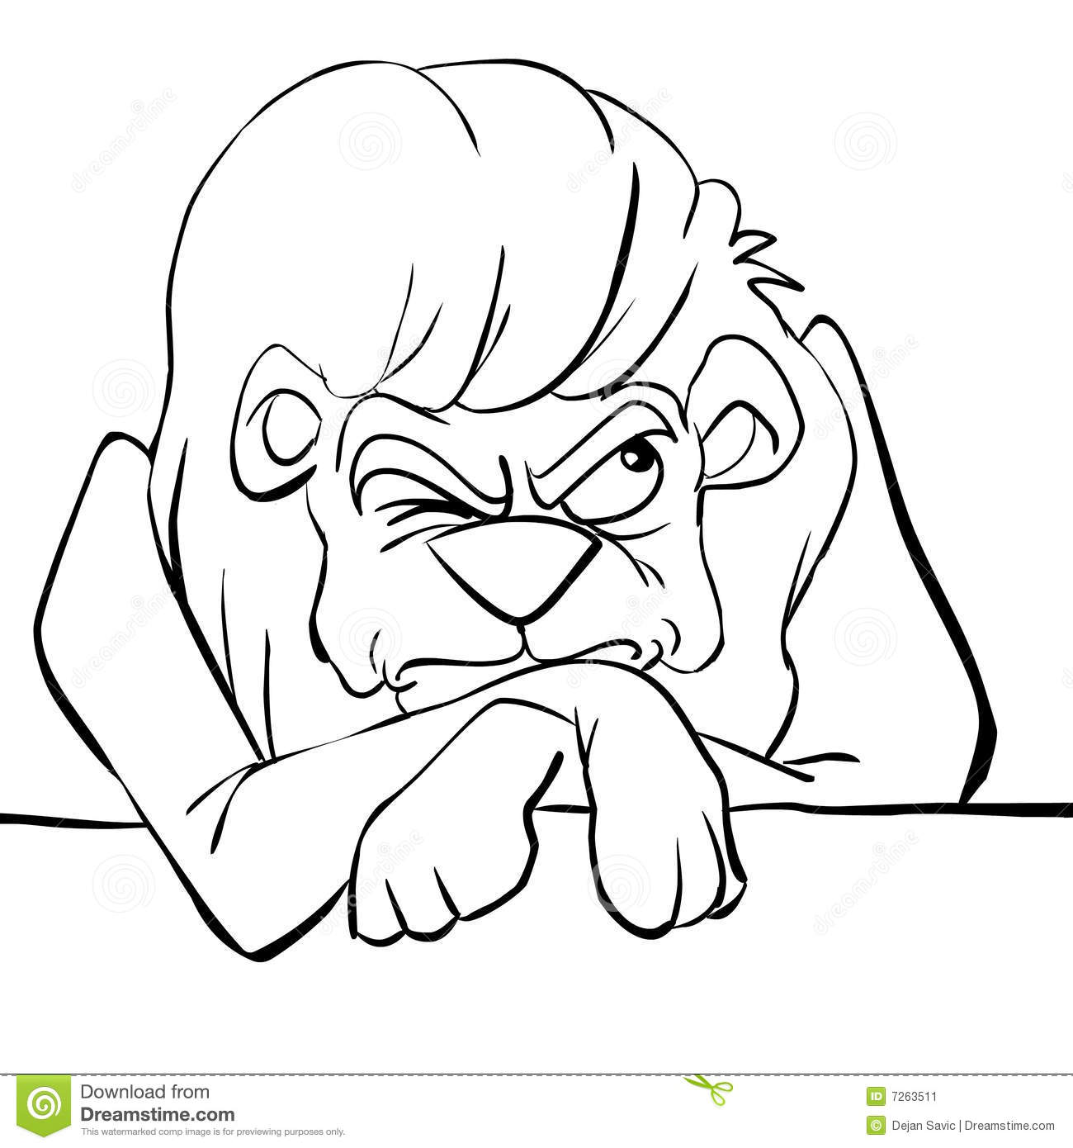
Malevolent
-trying to cause harm or evil
He wants to have a lawyer to save his son and the other young man and he tries to let his brother' son to pick up all crimes.

Slide 6
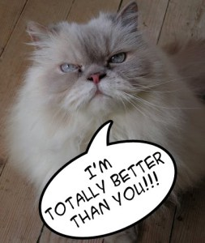
superiority complexes
The one who feels he is the best of the all. Also, who looks down the other people without any reason.

Slide 7
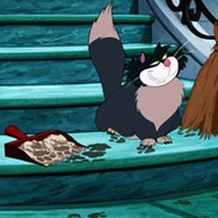
disloyal
People who don’t show respect to others and make their decisions without thinking.

Slide 8
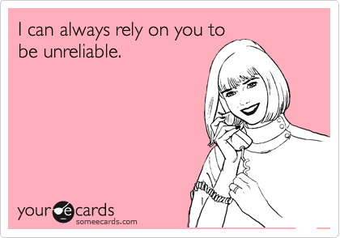
unreliable
Someone who is untrustworthy and cannot show the credible side.

Slide 9
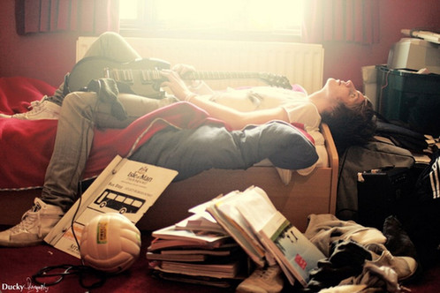
unrestrained
Not restrained or restricted:

Slide 10
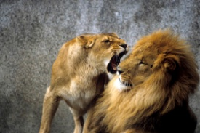
aggressive
Someone who easily gets mad at something and attacks.

Slide 11
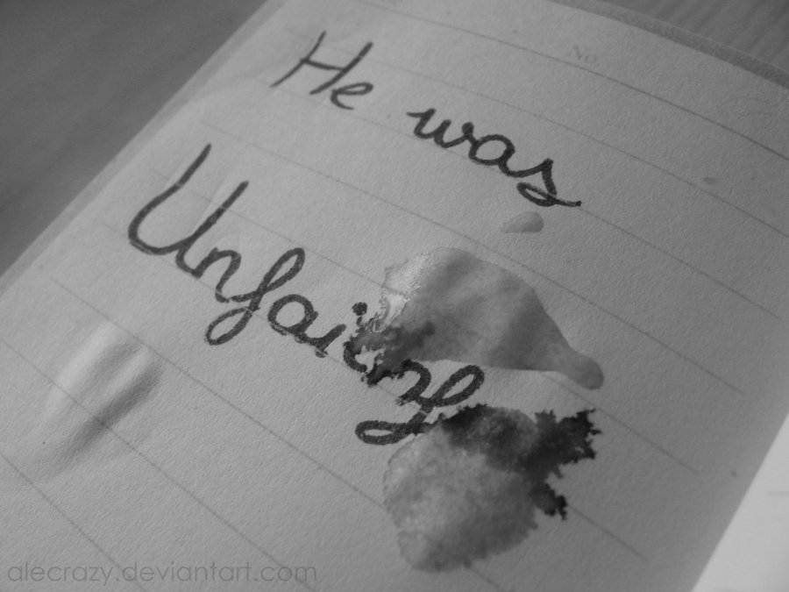
unfaithful
Not adhering to promises, obligations, or allegiances; disloyal.
- John was unfaithful to his ex wife because of his abandonment and irresponsibility.

Slide 12
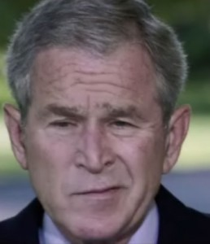
contemptuous
showing contempt; scornful.
- John was contemptuous of his brother Stephen when he came to the town for John.

Slide 13
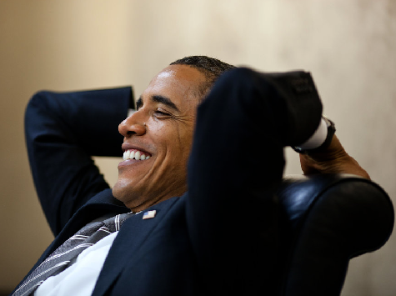
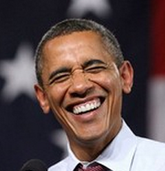
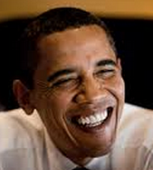
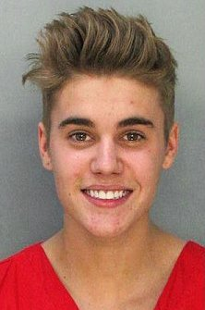
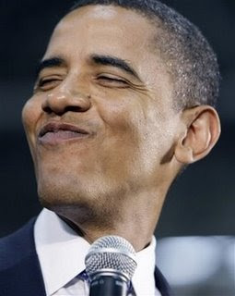
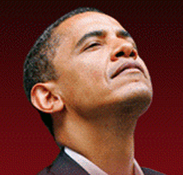
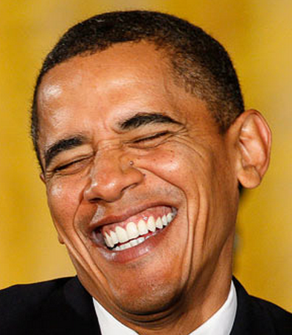
Self-satisfied
excessively and unwarrantedly satisfied with oneself or one's achievements; smugly complacent.
- John was self-satisfied of what he owns right now.

Slide 14
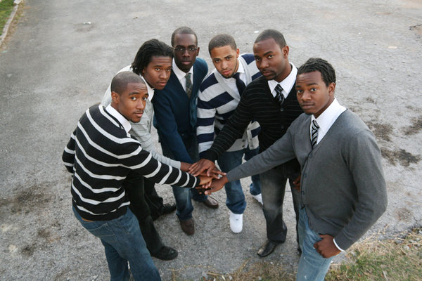
committed
feeling dedication and loyalty to a cause, activity, or job; wholeheartedly dedicated.
- John was committed to the law and the whites who made it.

Slide 15
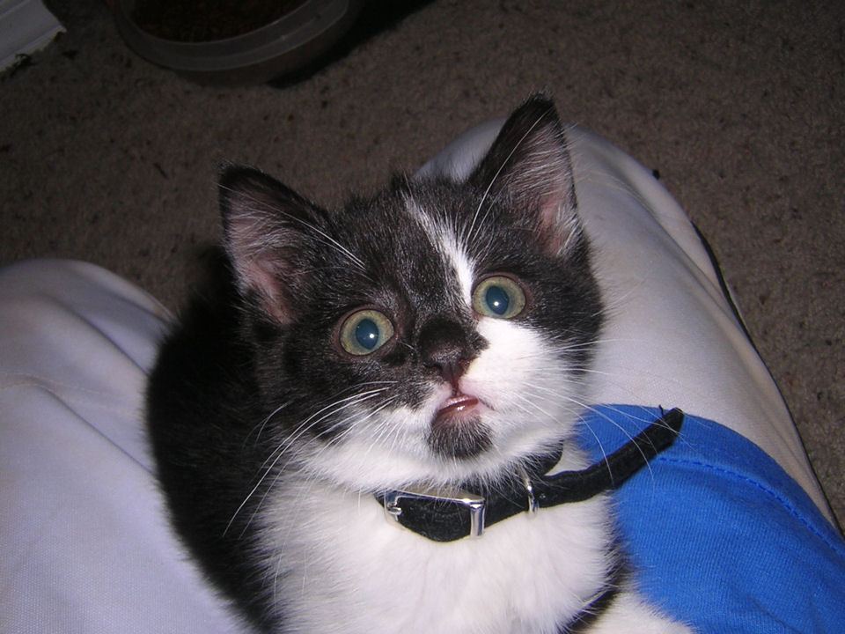
sinful
wicked and immoral; committing or characterized by the committing of sins.
- John was sinful because he tried to get his own brother Stephen into trouble for saving his own son and another man.

Slide 16
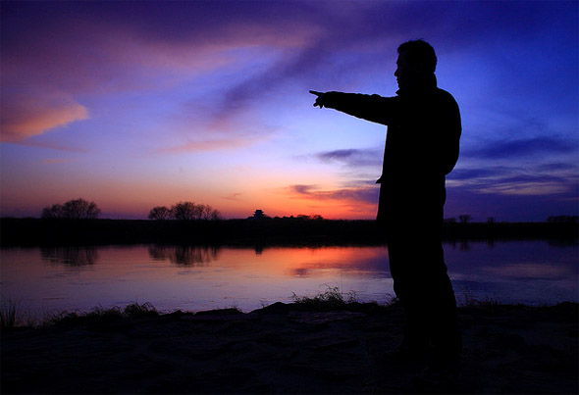
Ambitious
Definition: Having or showing a strong desire and determination to succeed.
Reason: In chapter 7, John Kumalo said “Down in Ndotsheni I am nobody, just as you are nobody, my brother.” “Here in Johannesburg I am a man of some influence.” Comparing these two quotes, we will find he want to be a person who has a high status.

Slide 17
Experienced
Definition:
Having had experience in an activity or in life in general
Reason:
Obviously, from the conversation between John Kumalo and his brother, I realize that he had undergone many things. Therefore, I use experienced to describe him.

Slide 18
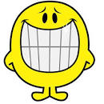
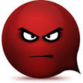
Mercurial
Definition: changeable
Reason:
The reason I think John is mercurial is that his mood was changeable. At the beginning of the conversation, his tone was friendly. But after a while, when he talked about those high buildings, his voice liked a louder voice of a bull or a lion.

Slide 19
Aroused
Definition: Very excited
Reason:
When he talked about the white and those people who were lying in the hospital, he was aroused about them.

Slide 20
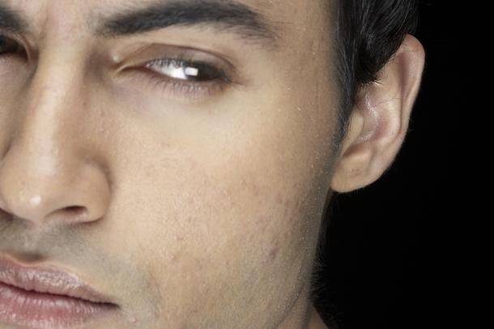
Resentful
Definition: feeling or expressing bitterness or indignation at having been treated unfairly.
Reason: He was resentful about what the white did to the black. He believed there was many unfair things such as the white did not think there was the chance to pay more to his labors when the white brought more of the labors to live in the compound. So he hated the white.

Slide 21
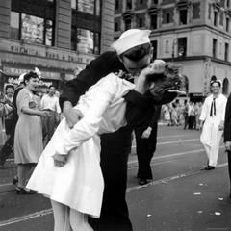
Ardent
very enthusiastic or passionate

Slide 22
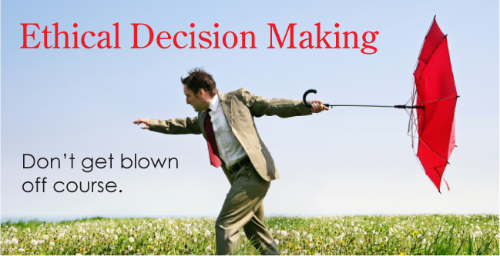
Ethical
relating to moral principles or the branch of knowledge dealing with these

Slide 23
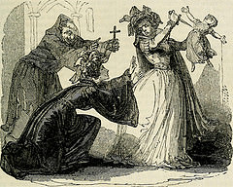
Impetuous
acting or done quickly and without thought or care

Slide 24
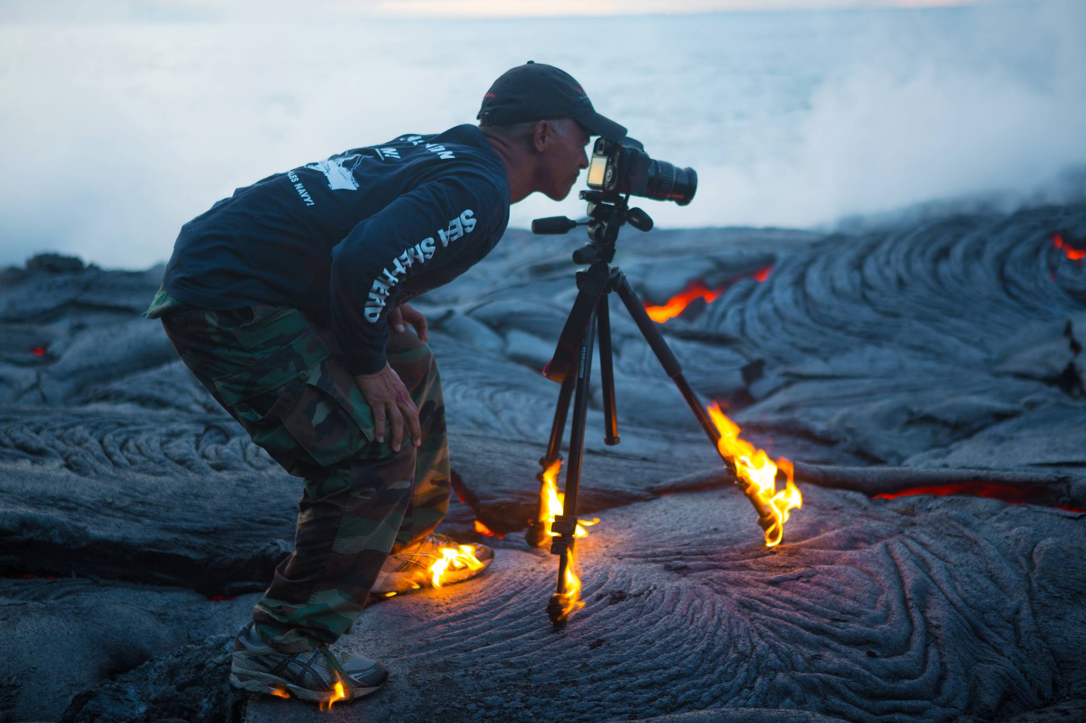
Passionate
having, showing, or caused by strong feelings or beliefs

Slide 25
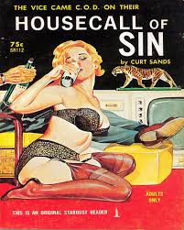
Libertine
a person, especially a man, who freely indulges in sensual pleasures without regard to moral principles.

Slide 26
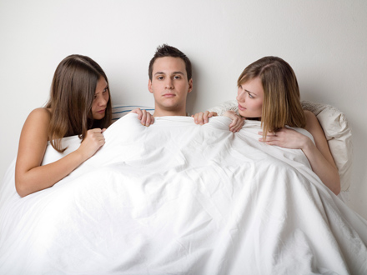
promiscuous
Promiscuous means someone is loose in morals.
In Chapter 7, John said his wife leave him because of infidelity.

Slide 27
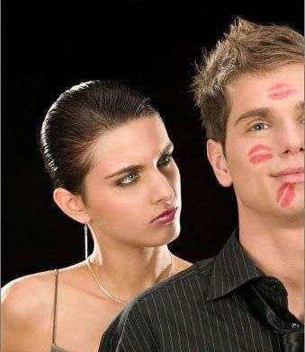
licentious
Licentious means someone is loose in morals.
In Chapter 7, John told the umfundisi that his wife leave him because of infidelity.

Slide 28
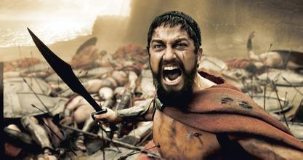
indignant
Indignant means someone is angry about something.
In chapter 7, John was angry about the situation in Johannesburg.

Slide 29
fervent
Fervent means someone is very passionate.
In chapter 7, John welcomed the Umfundisi with some fervent words.

Slide 30
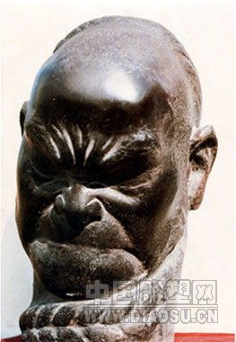
resentful
Resentful means someone is unsatisfied with something.
In Chapter 7, John said that it was unfair between black people and white people

Slide 31
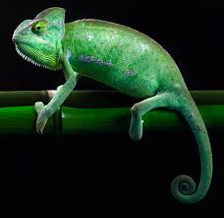
Adaptable
Describe someone who can adapt into a new environment easily.
Because John adapted in this city perfectly, not like his sister.

Slide 32
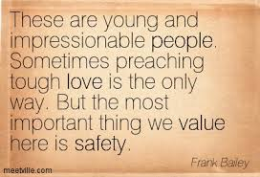
Impressionable
Describe someone who can be affected easily.
After coming to this city, John was affected and no longer believed in god.

Slide 33
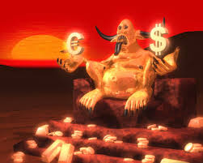
Snobbish
Describe someone who only care about money and fame.
Because John enjoys his rich life and doesn’t want to go back.

Slide 34
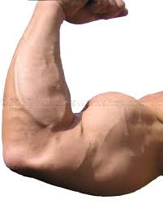
Capable
Describe someone who have ability to do something.
Black was discriminated at that time, but John can still being successful and rich.

Slide 35
Faithless
Describe someone who doesn’t have belief.
Because John believes in law instead of god.

