Slide 1
Courteous
Definition: polite, respectful, or considerate in manner.
Reason: According to his words, I can feel he was a gentle and polite man. No matter who he was talking to, he always said “Thank you” and never used some rude words. So I use “courteous” to describe him.

Slide 2
COMPASSIONATE
Definition: feeling or showing sympathy and concern for others
Reason: The reason why I said he is compassionate is because he was asking the situation for the children and felt sympathetic about them on chapter 6. “Why are they not at school?” This sentence showed Kumalo felt bad and worried for the poor situation of children.

Slide 3
FAITHFUL
Definition: loyal; adhering firmly to person or cause
Reason: It is not easy to see he was a faithful man. However, when we focus on the conversation from him and his sister, you will find something interests. Because he was a priest, in his mind, his job is holy. But his sister did something that is cheap and humble, so he said “ you have shamed us.” The word “shame” shows how angry Kumalo is and his loyalty to his belief.

Slide 4
ACCOUNTABLE
Definition: (of a person, organization, or institution) required or expected to justify actions or decisions; responsible.
Reason: The reason why I consider Kumalo as accountable is because he went to the Johannesburg immediately when he know his sister or his son news. From this detail, we are able to know Kumalo is responsible.

Slide 5
KINDHEARTED
Definition: Having a kind and sympathetic nature.
Reason: Obviously, when he asked the question about those children who can not go to school, we are able to understand that he was a kindhearted man.

Slide 6
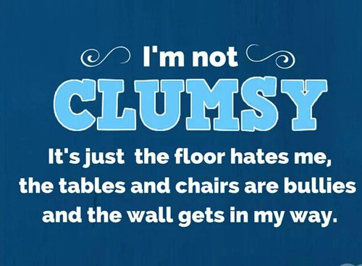
Clumsy
awkward in movement or in handling things.

Slide 7
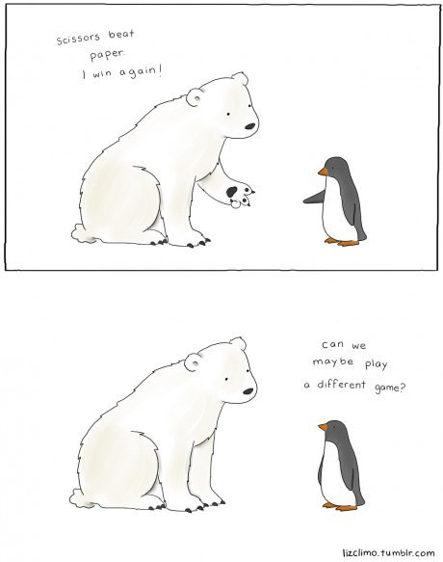
Gracious
courteous, kind, and pleasant.

Slide 8
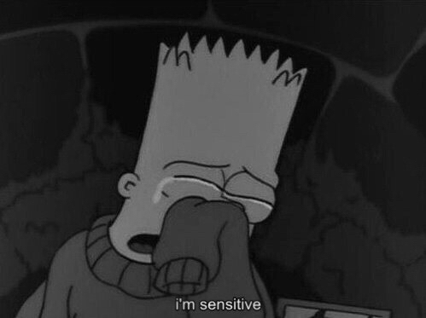
Sensitive
having or displaying a quick and delicate appreciation of others' feelings.

Slide 9
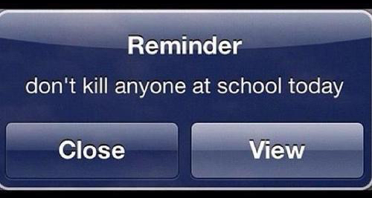
Ethical
of or relating to moral principles or the branch of knowledge dealing with these.

Slide 10
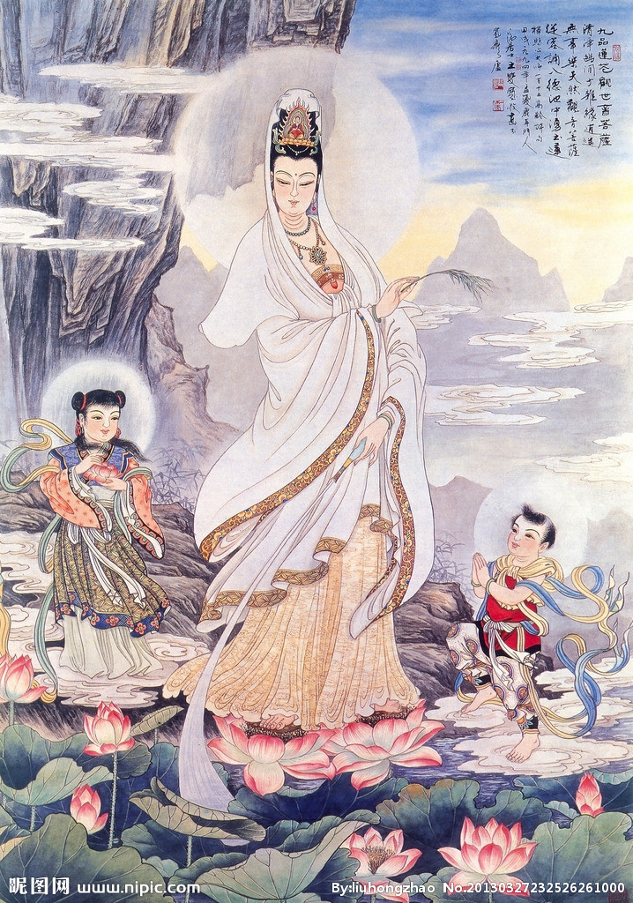
amiable
Amiable means someone is kind and warm.
In chapter 2, after the little girl brought the letter to the umfundisi, the umfundisi gave some food to the girl and showed his kindness.

Slide 11
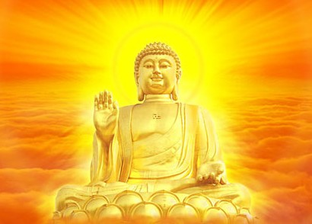
lenient
Lenient means someone is magnanimous or generous.
In chapter 4, although the umfundisi knew he was cheated, he didn’t blame too much.

Slide 12
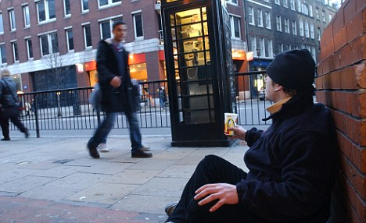
compassionate
Compassionate means someone is sympathetic. For example, helping the poor people or the animals.
In chapter 2, he felt sympathy for the little black girl.

Slide 13
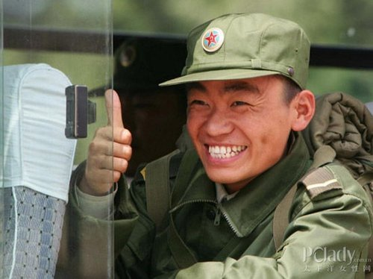
veridical
Veridical means someone is honest and frank.
In chapter 4, the umfundisi was cheated by such a simple trick.

Slide 14
Humane
Humane means someone is merciful and benevolent.
In chapter 6, after he found his sister, he didn’t show a great deal of anger, instead, he tried to help her.

Slide 15
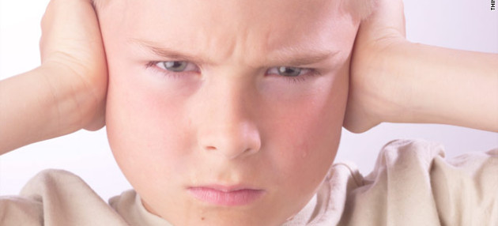
Obstinate:
Refusing to change mind or be persuaded to do something else.
['ɑbstɪnət]
Synonym: resistant, stubborn

Slide 16
Unremitting:
Keeping doing something and never give up
[,ʌnrɪ'mɪtɪŋ]
Synonym: ongoing, uninterrupted

Slide 17
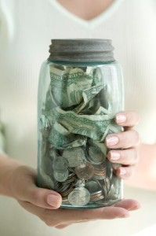
Frugal:
Do not spend too much money on themselves
['fruɡl]
Synonym: plain

Slide 18
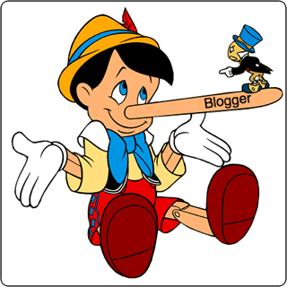
Credible:
It can be believed
['krɛdəbl]
Synonym: reliable
I am incredible

Slide 19
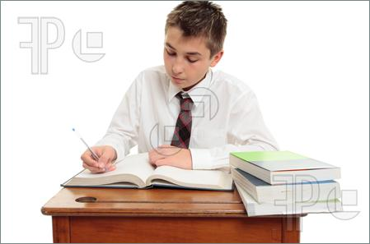
Conscientious:
Having responsibility
['kɑnʃɪ'ɛnʃəs]
Synonym: responsible

Slide 20
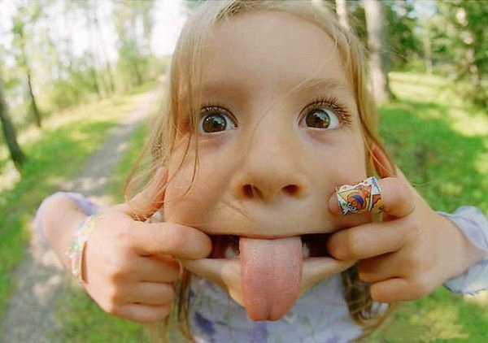
Innocent
Innocent mean lacking in sophistication.
Because when he went to the city he was cheated by others.

Slide 21
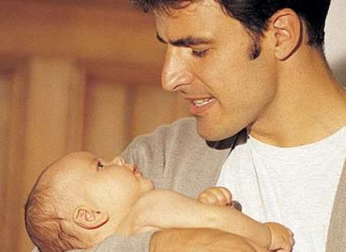
Paternal
Paternal mean relating to or characteristic of or befitting a parent.
It showed when he kissed his nephew and cleaned his face, and tried his best to helped his sister.

Slide 22
Earnest
Earnest people are very serious and sincere in what they say or do, because they think that their actions and beliefs are important.
Because he tried his best to helped and found his relative.

Slide 23
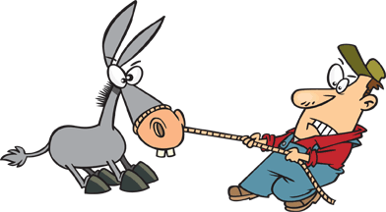
Stubborn
Someone who is stubborn or who behaves in a stubborn way is determined to do what they want and is very unwilling to change their mind.
Because he still think Johannesburg is bad place.

Slide 24
Nescient
Nescient mean lacking knowledge or sophistication.
Because when he went to the city he was cheated by others.

Slide 25
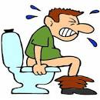
Tolerate (/ˈtäləˌrāt)
Definition- suffering from other things and. It’s like a sufferance.

Slide 26
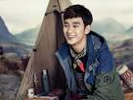
Gentleness
Definition- Is like a kindness and softness.

Slide 27
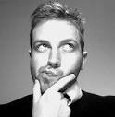
Thoughtful
Definition- considering something too much.

Slide 28
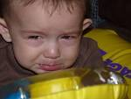
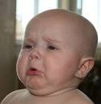
Pitiful
Definition- no money and they are hungering from foods

Slide 29
sensitive
Definition- It’s easy to feel and able to perceive sensation.

Slide 30
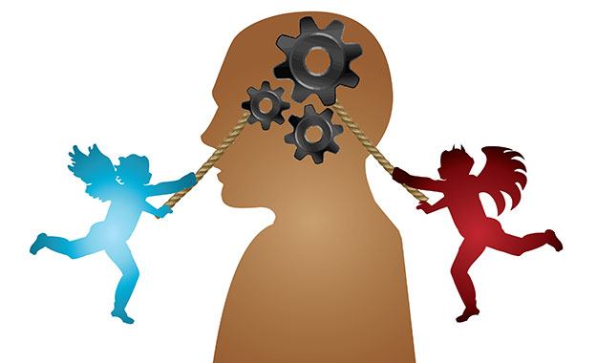
Ethical
Relating to moral or the branch of knowledge dealing with moral

Slide 31
Pessimistic
tending to the negative or unfavorable or to take the gloomiest view.

Slide 32
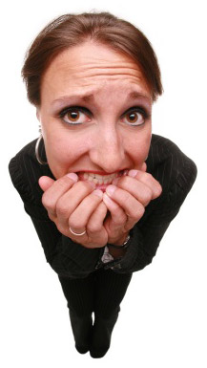
Anxious
feeling or showing worry, nervousness because of fear of danger or an misfortune outcome.

Slide 33
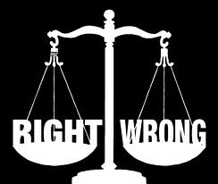
Moral
concerned with the principles of right and conduct between right and wrong.

Slide 34
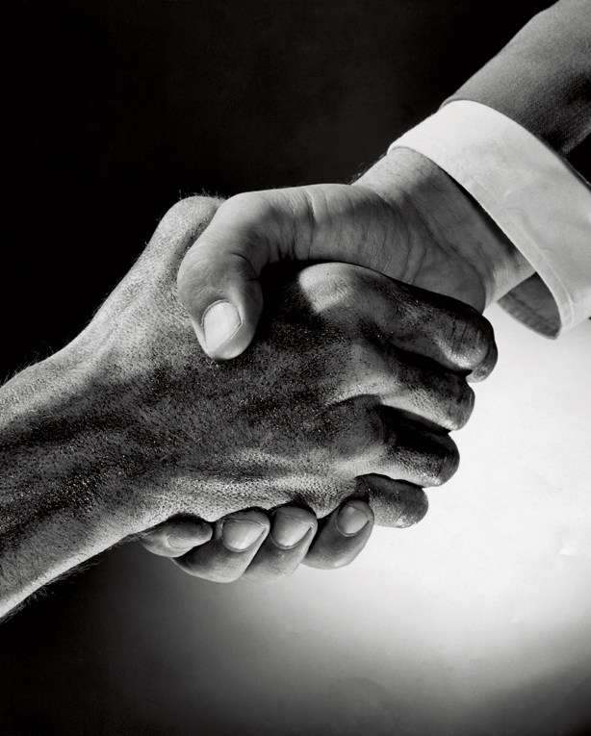
Gracious
very polite in a way that shows respect. Especially towards someone of lower social status.

Slide 35
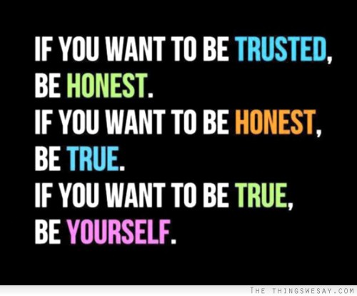
Honest
The people always tell the truth, and do not try to deceive people or break the law

Slide 36
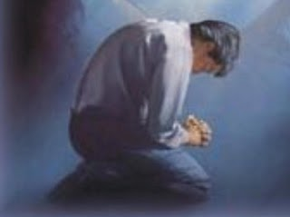
Humble
People with low social status

Slide 37
Instructed
Someone who has been educated

Slide 38
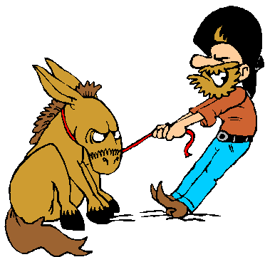
Stubborn
Describe people who do they want and is very unwilling to change their mind

Slide 39
Tolerated
Are able to bear something bad or painful

Slide 40
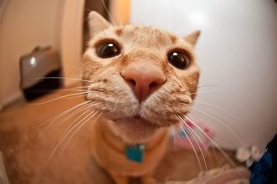
Naive
Describe people who is lack of experience and believe everything is going as good as he thought.
Because Stephen was cheated when he just came to this city.

Slide 41
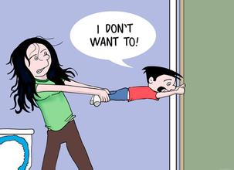
Clinging
Describe people who will be persist on doing something which he wants to do.
Because Stephen still went to this city, even though his wife was opposed.

Slide 42
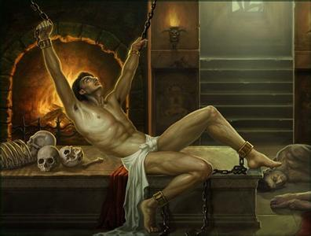
Humble
Describe someone who is in lowest class.
Because Stephen is a black, at that time the Black was discriminated.

Slide 43
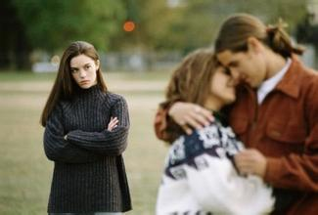
Tolerant
Describe some who can control his anger easily.
Because Stephen was very angry about what his sister had done, but he still be patient and nice.
F*** Y**

Slide 44
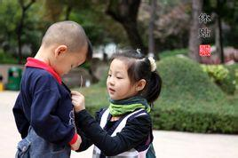
Considerate
Describe some who cares about others.
Because he noticed the girl which sent message to him was hungry.

Slide 45
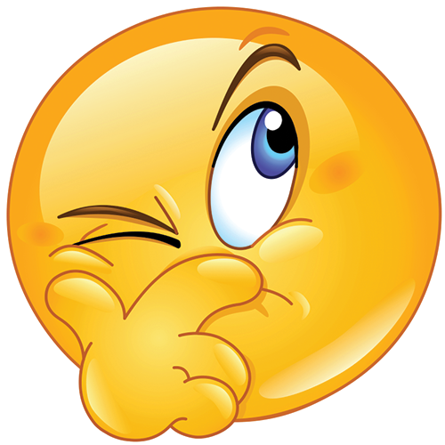
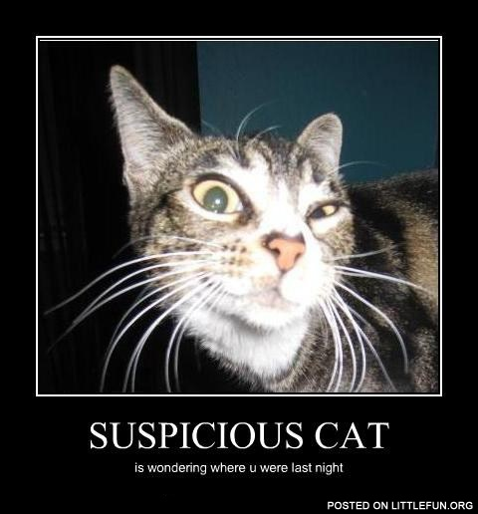
suspicious
[səˈspɪʃəs]
Having or showing a cautious distrust of someone or something.
In chapter 6, Kumalo know his sister have a child, but he didn’t see the child, so he felt suspicious

Slide 46
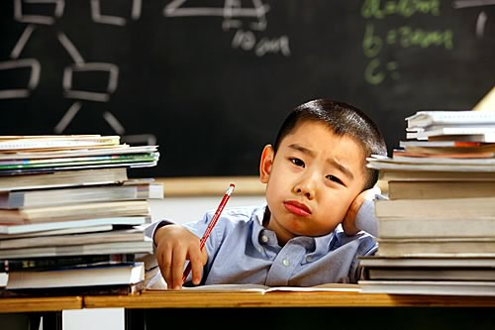
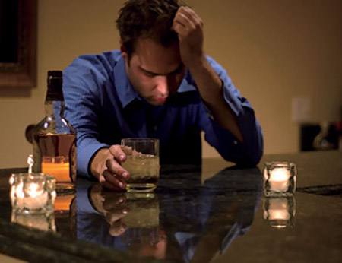
Anxious
[ˈæŋkʃəs]
Worry, nervousness, or unease about someone
In chapter 2, after Kumalo know his sister was very sick, he was so worry about hers.

Slide 47
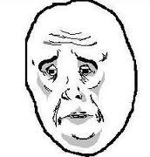
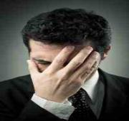
Ashamed
[ə'ʃeɪmd]
Feel sorry or shy for somesone or something.
In chapter 5, After Kumalo heard her sister may have many husbands, Kumalo said “My God, oh my God.” he felt shy

Slide 48
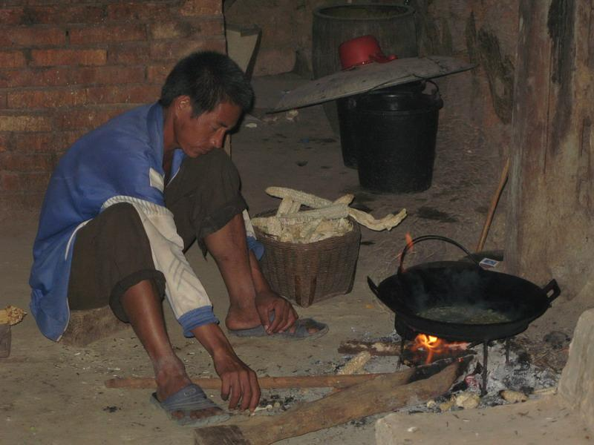
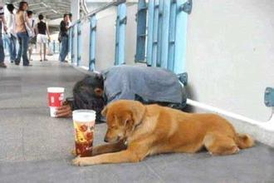
Burdensome
[ˈbɜ:dnsəm]
Difficult.
In chapter 6, Kumalo’s sister said she have no money for the child, it show peoples are living difficult.

Slide 49
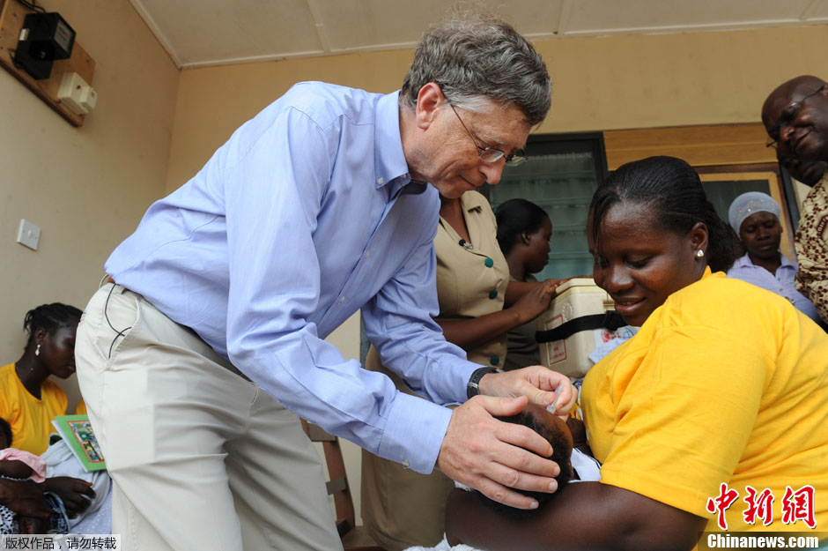
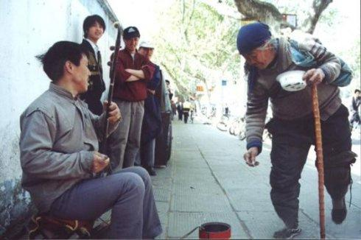
eleemosynary
[ˌeli:'mɒsɪnərɪ]
Support poor peoples by charity.
In chapter 2, Stephen Kumalo sented the girl to gave her the letter to the kitchen for some food. It is a eleemosynary activity.

